Slide 1
Metasploit
Chisom Ukaegbu and Andrew Bernal

Slide 2
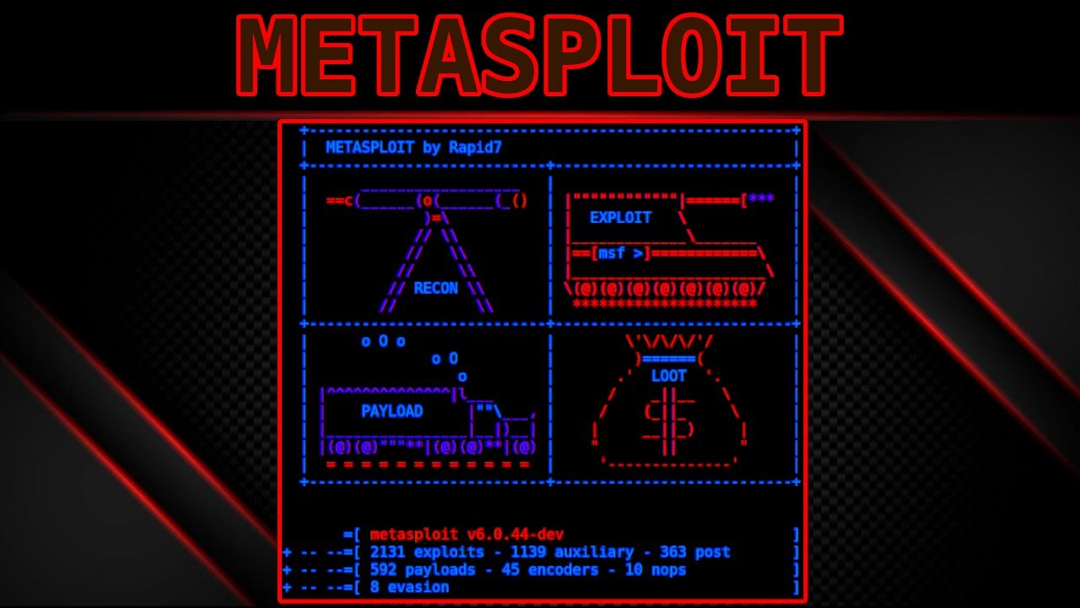
What is Metasploit
Popular open-source penetration testing framework
Framework for sending malicious payloads/modules.
Takes advantage of out-of-date systems.
Useful if you want to speedrun your way to prison…

Slide 3



History

Slide 4
Metasploit Modules
1. Auxiliary Modules
3. Payload Modules
2. Exploit Modules
Code packages that scan and provide information about a target machine
Once you gained access through abusing an exploit, payloads allow you to install software(once inside).
Code packages that allow access into a vulnerable machien

Slide 5

First Steps: Scanning

Slide 6
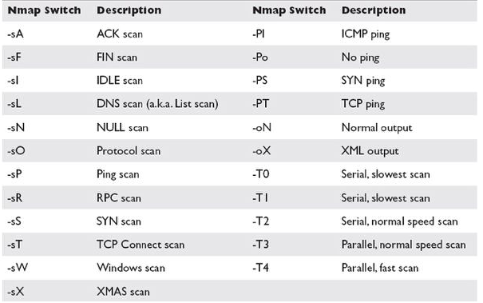
Nmap Flags

Slide 7
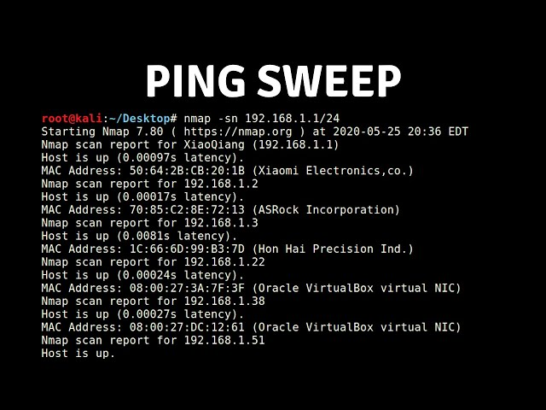

Slide 8
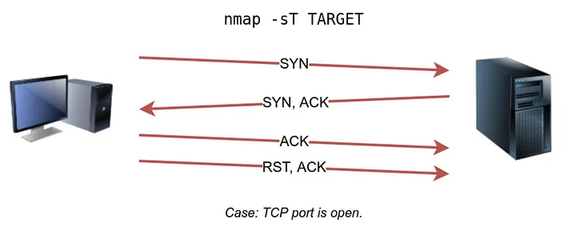
TCP 3 Way Handshake

Slide 9
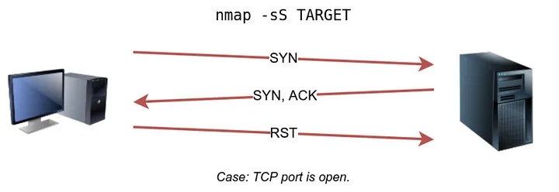
TCP Syn Scan, no handshake

Slide 10
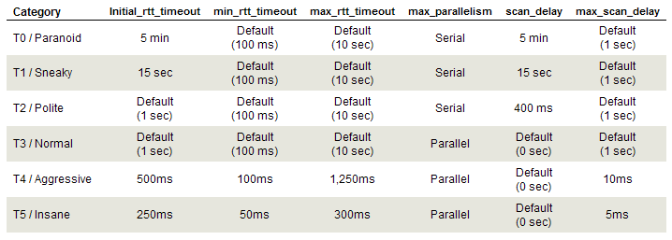
Scan Speeds

Slide 11
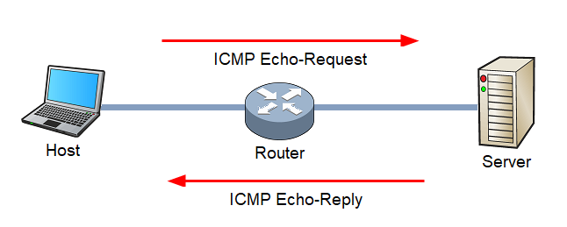
What is Ping (-Pn)

Slide 12

Windows Firewall Blocks Ping

Slide 13

Demo: Database, scan, search, use

Slide 14
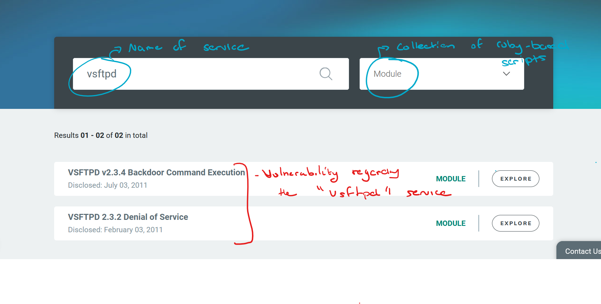
Finding Vulnerabilities
Online Vulnerability database:
https://www.rapid7.com/db/
https://nvd.nist.gov/

Slide 15
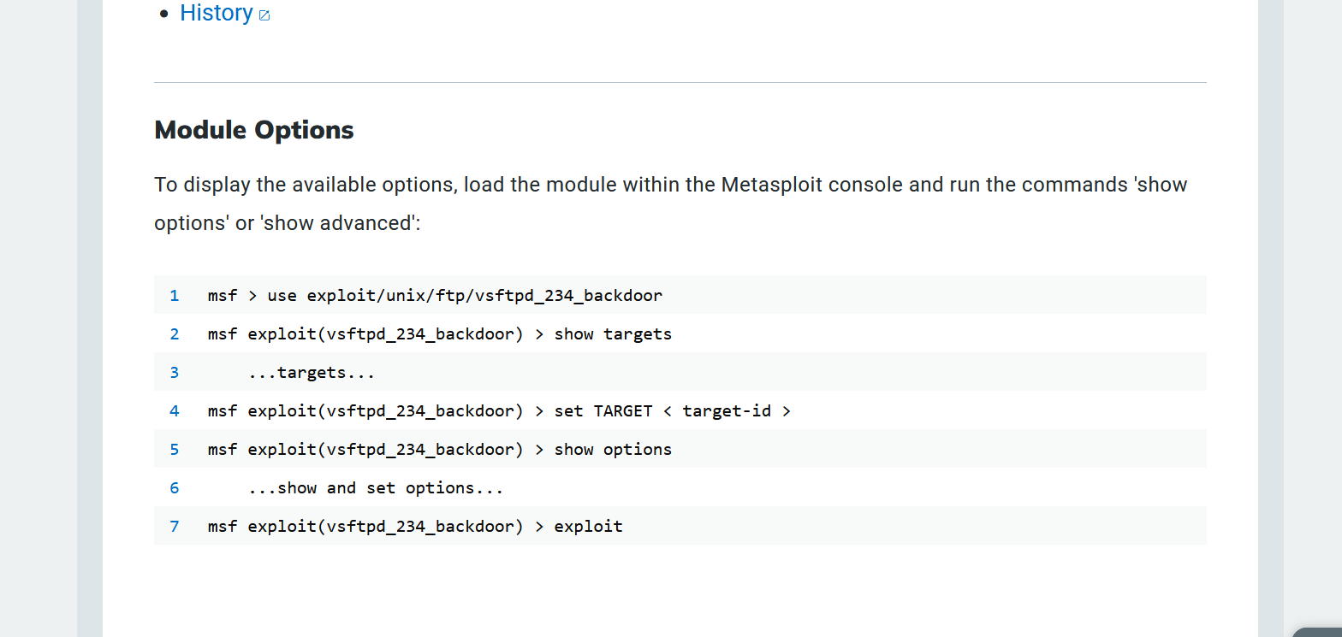
Exploiting Vulnerabilities

Slide 16
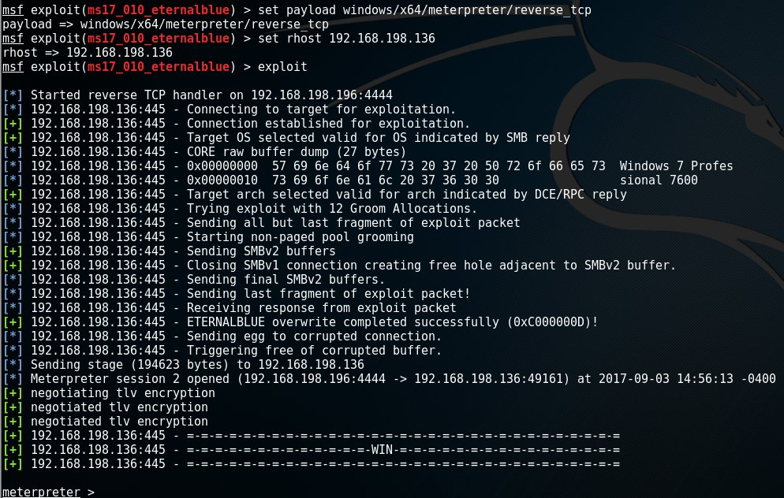
Reverse TCP shell

Slide 18

Lab: Using Metasploit
Go to https://umlcyber.club/posts/meeting_2
Or https://github.com/UML-Cyber-Security/Fall_2023/blob/main/Meeting_2_Metasploit/lab_2.md

